Slide 1
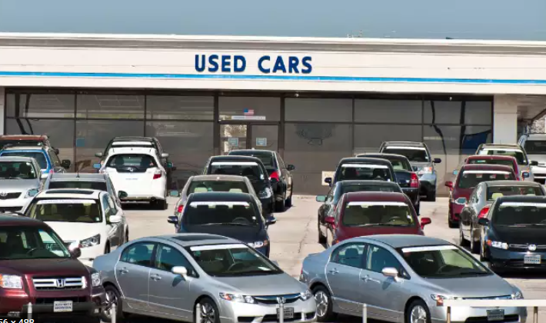
Car Price Prediction Project Presentation
Submitted by:
Anubhav Saxena

Slide 2
ACKNOWLEDGMENT
I'd like to express my heartfelt gratitude to Shubham Yadav, my SME (Subject Matter Expert), as well as Flip Robo Technologies, for allowing me to work on this project on Car Price Prediction and for assisting me in conducting extensive research, which allowed me to learn a lot of new things, particularly in terms of data collection.
In addition, I used a few other resources to assist me finish the job. I made sure to learn from the samples and adjust things to fit my project's needs.

Slide 3
ACKNOWLEDGMENT
All the external resources that were used in creating this project are listed below:
1) https://www.google.com/
2) https://www.youtube.com/
3) https://scikit-learn.org/stable/user_guide.html
4) https://github.com/
5) https://www.kaggle.com/
6) https://medium.com/
7) https://towardsdatascience.com/
8) https://www.analyticsvidhya.com/

Slide 4
PROBLEM STATEMENT
We've seen a lot of changes in the automotive market as a result of the Covid 19's influence. Some automobiles are in high demand, making them expensive, while others are not, making them less expensive. One of our clients sells secondhand automobiles through tiny merchants. Our customer is having issues with their prior automobile price estimation machine learning models owing to market changes caused by the impact of Covid 19. As a result, they're on the lookout for new machine learning models based on new data. We need to create a methodology for valuing automobiles.

Slide 5
DATA COLLECTION PHASE
You have to scrape at least 5000 used cars data. You can scrape more data as well, it’s up to you. more the data better the model
In this section You need to scrape the data of used cars from websites (OLX, Car Dekho, Cars 24 etc.) You need web scraping for this. You have to fetch data for different locations. The number of columns for data doesn’t have limit, it’s up to you and your creativity.
Generally, these columns are Brand, model, variant, manufacturing year, driven kilometers, fuel, number of owners, location and at last target variable Price of the car. This data is to give you a hint about important variables in used car model. You can make changes to it, you can add or you can remove some columns, it completely depends on the website from which you are fetching the data.
Try to include all types of cars in your data for example- SUV, Sedans, Coupe, minivan, Hatchback.

Slide 6
MODEL BUILDING PHASE
After collecting the data, you need to build a machine learning model. Before model building do all data pre-processing steps. Try different models with different hyper parameters and select the best model. Follow the complete life cycle of data science. Include all the steps below.
1. Data Cleaning
2. Exploratory Data Analysis
3. Data Pre-processing
4. Model Building
5. Model Evaluation
6. Selecting the best model

Slide 7
DATA SCIENCE LIFE CYCLE
Data Cleaning
Import the collected data from web scraping
Exploratory Data Analysis
Check through all the dataset information like datatype, missing value, duplicate value etc.
Visualization and Data Preprocessing
Use various visualization methods to check the data distribution identify presence of outliers and skewness
Clean and format the records as per usage by using various imputation techniques
Analyze each and every data record to ensure we have usable information
Perform encoding and scaling methods

Slide 8
DATA SCIENCE LIFE CYCLE
Model Building
Create appropriate Regression Machine Learning model function
Model Evaluation
Usage of evaluation metrics to check the accuracy of the models over trained and test data inputs
Hyperparameter Tuning Best Model
Choosing the appropriate Regression Machine Learning model to check various parameter permutation and combinations
Need to ensure that whenever the regression function is called it is able to process all the necessary parameters
Ensure the cross validation techniques helps in reducing over fitting and under fitting data
Using Grid Search CV to obtain the best parameters that can be plugged into the selected model

Slide 9
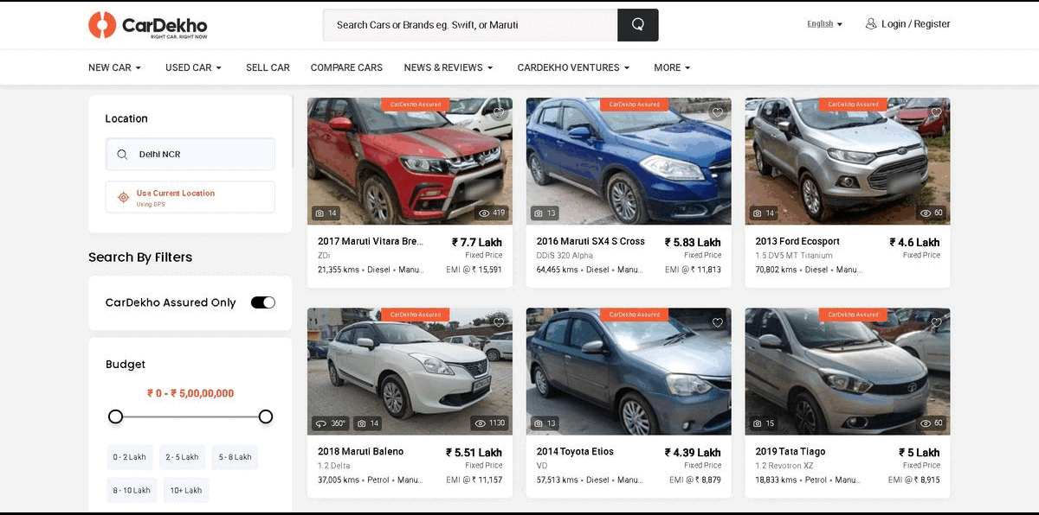
WEB SCRAPING FOR USED CAR DETAILS

Slide 10
DATA PREPROCESSING
Importing the necessary dependencies and libraries.
Reading the CSV file and converted into data frame.
Checking the data dimensions for the original dataset.
Looking for null values and accordingly fill the missing data.
Checking the summary of the dataset.
Checking unique values.
Checking all the categorical columns in the dataset.

Slide 11
DATA PREPROCESSING
Visualizing each features using matplotlib and seaborn.
Performing encoding using the ordinal encoder on categorical features.
Checking for co-relation/multi-collinearity in a heatmap.
Checking for Outliers/Skewness using boxen plot and distribution plot.
Perform Scaling using Standard Scaler method.
Checking for the final dimension of dataset to confirm the input details.
Creating train test split and the best random state found in the range 1-1000.

Slide 12
TECHNOLOGY USED
Hardware technology being used.
RAM : 8 GB
CPU : Intel(R) Core(TM) i3-7100U CPU @ 2.40GHz 2.40 GHz
Software technology being used:
Programming language : Python
Distribution : Anaconda Navigator
Browser based language shell : Jupyter Notebook
Libraries/Packages specifically being used.
Pandas, NumPy, matplotlib, seaborn, scikit-learn, pandas-profiling, missingno

Slide 13
EXPLORATORY DATA ANALYSIS (EDA) AND VISUALIZATION
01. Univariate Analysis
02. Multivariate Analysis
03. Correlation of Dataset
Univariate analysis is the simplest form of analyzing data. “Uni” means “one”, so in other words your data has only one variable.
Multivariate analysis is a set of statistical techniques used for analysis of data that contain more than one variable.
Correlation is used to test relationships between quantitative variables or categorical variables.
04. Correlation with Target variable
05. Conclusion
Correlation with the target variable to know how the data is related.
Summary with the conclusion of all the analysis

Slide 14
EXPLORATORY DATA ANALYSIS (EDA)
Shape : 10,000 rows and 6 columns
No null values present
Few duplicate rows/records were found
Datatype of only object columns are in dataset
First I have imported the necessary libraries and loaded the entire dataset in our Jupyter Notebook and renamed the project file from untitled.
Then I checked the shape of our dataset and found that we have a total of 10,000 rows and 6 different columns.
We don’t have any null values or missing values present in our dataset from the web scraping.
There few duplicate rows/records in our dataset but I decided to retain them instead of deleting it.
By checking the data types I came to know that our data set consists of columns having only object datatype even those there were numeric information present.

Slide 15
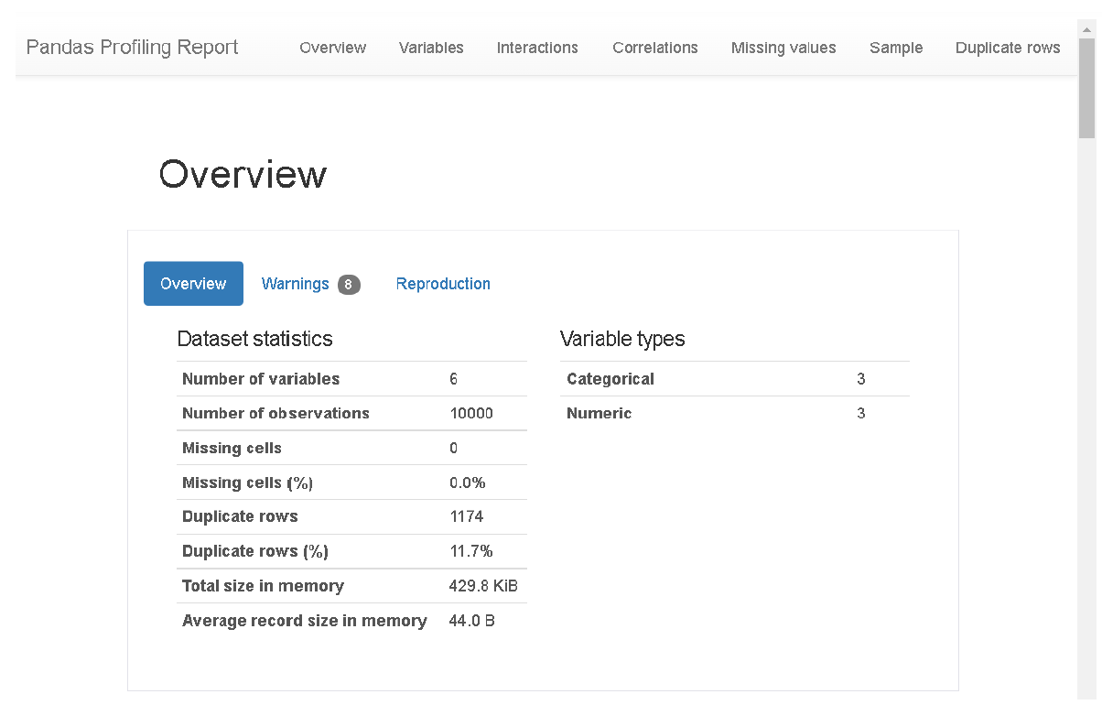
VISUALIZATION USING PANDAS PROFILING REPORT

Slide 16
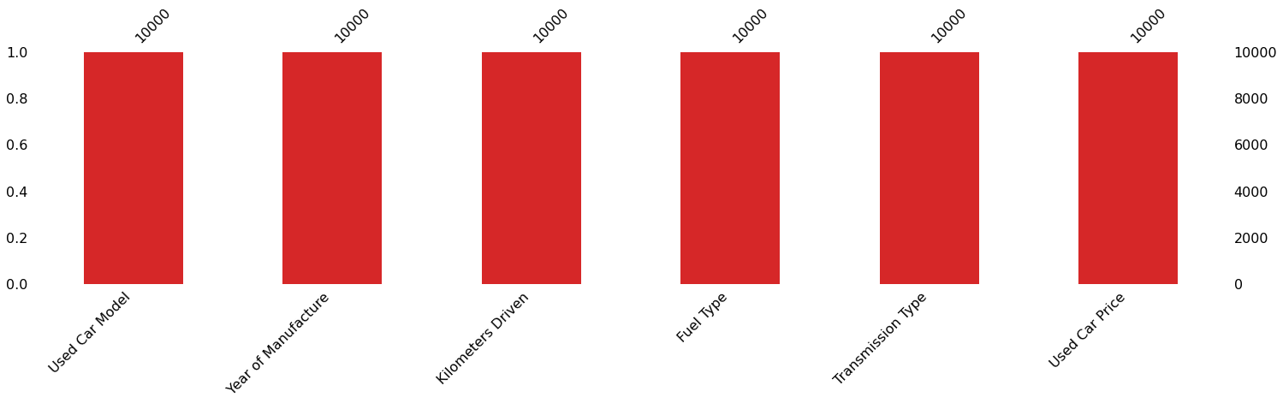
MISSING VALUES VISUAL USING MISSINGNO

Slide 17
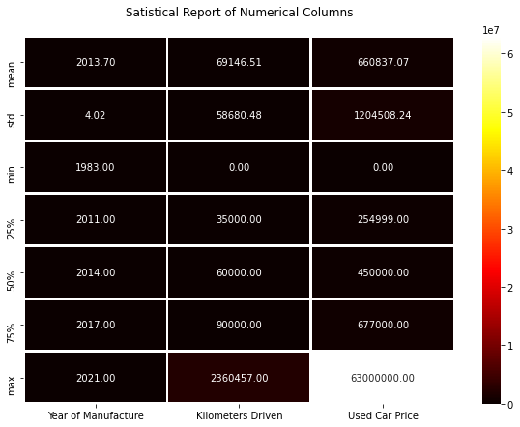
DESCRIBE DATASET VISUAL ON NUMERIC DATA

Slide 18
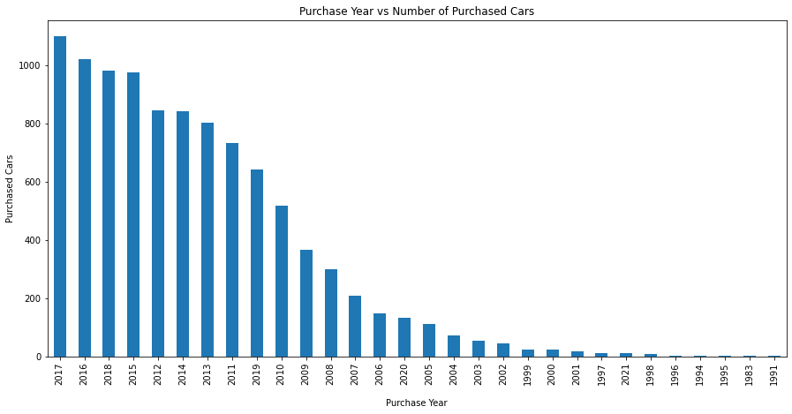
PURCHASE DETAILS OF USED CARS EACH YEAR

Slide 19
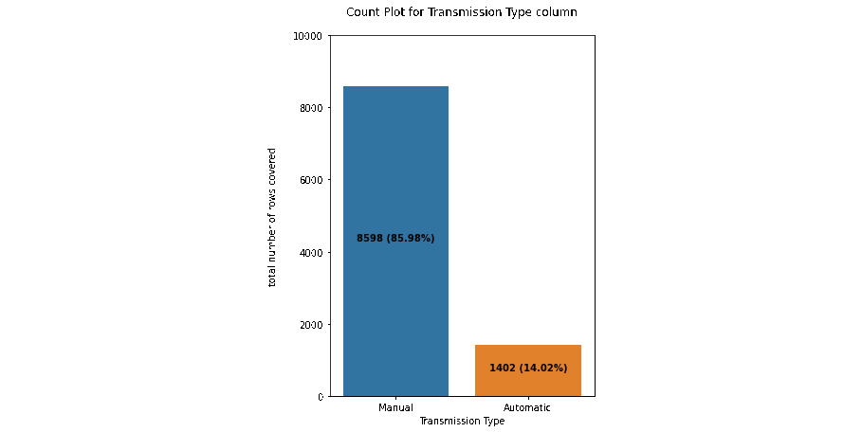
COUNT PLOTS

Slide 20
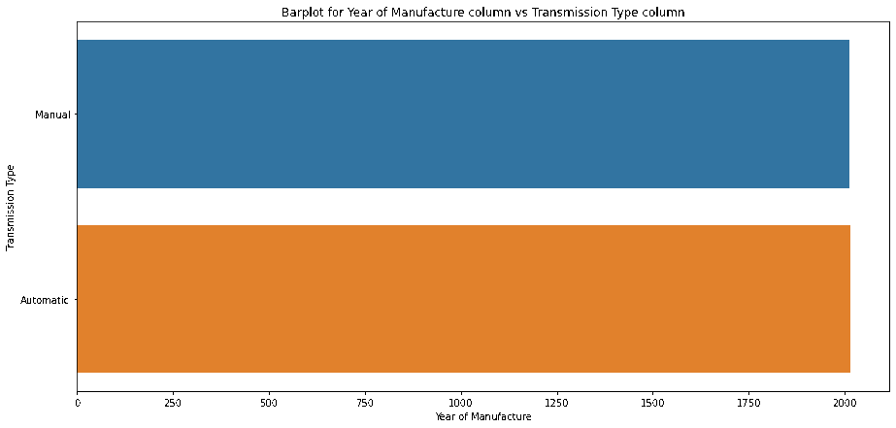
BAR PLOTS

Slide 21
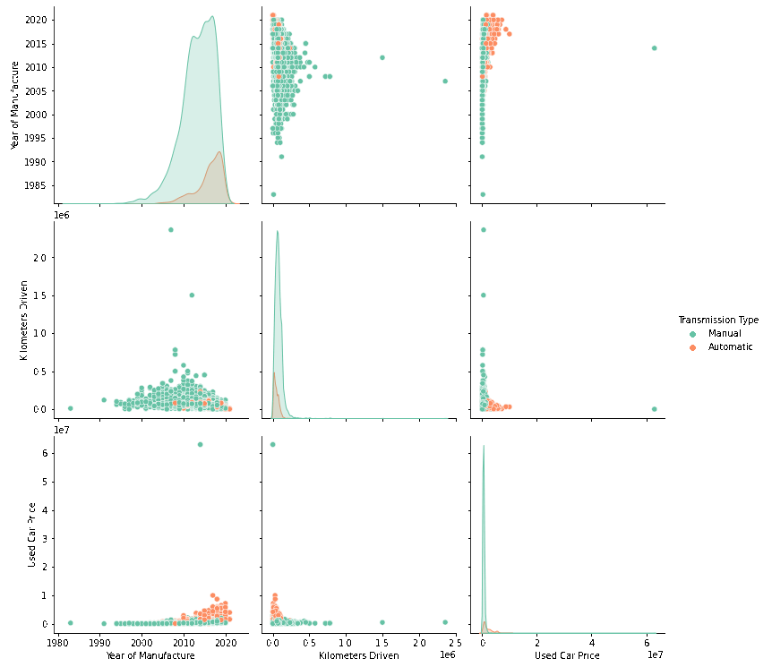
PAIR PLOTS

Slide 22
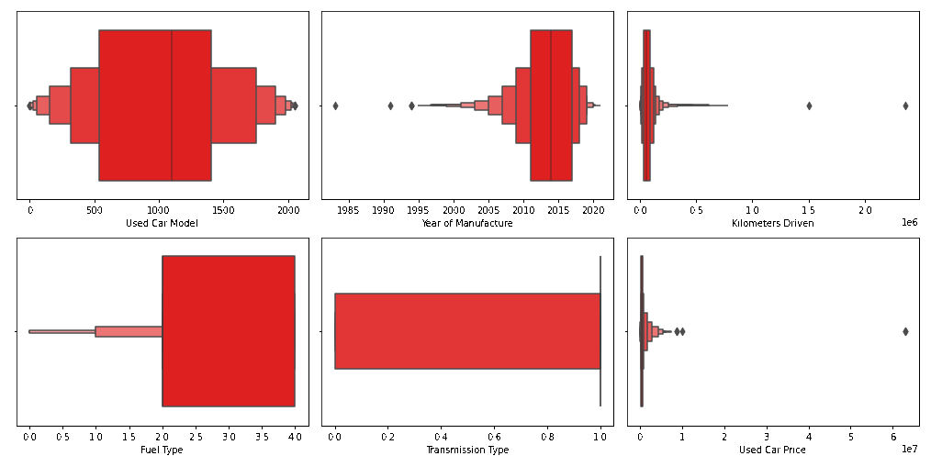
OUTLIERS WITH BOXEN PLOTS

Slide 23
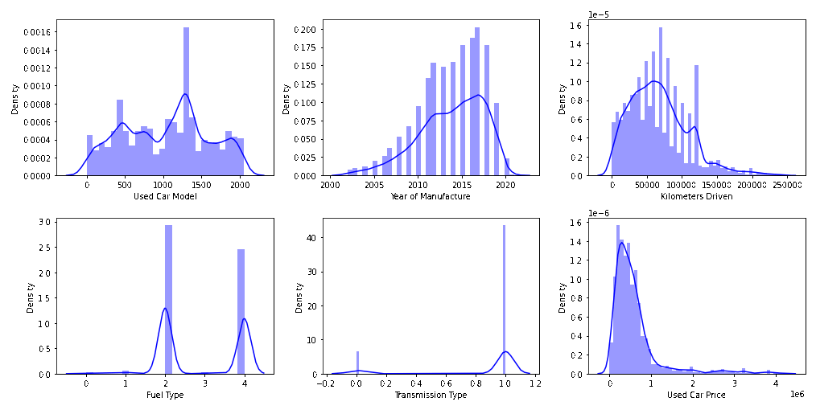
SKEWNESS WITH DISTRIBUTION PLOTS

Slide 24
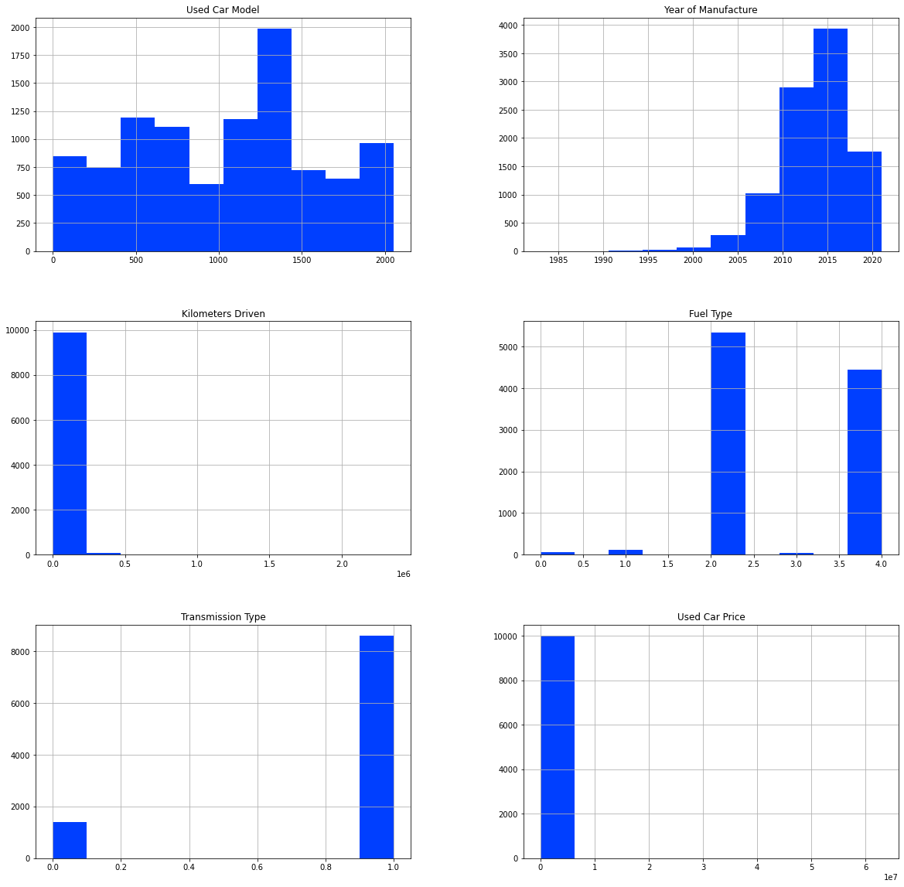
HISTOGRAM

Slide 25
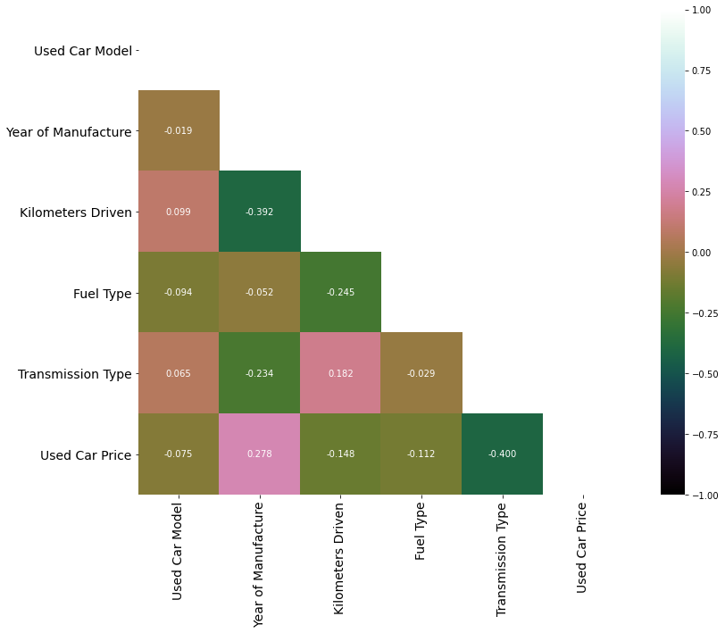
HEATMAP

Slide 26
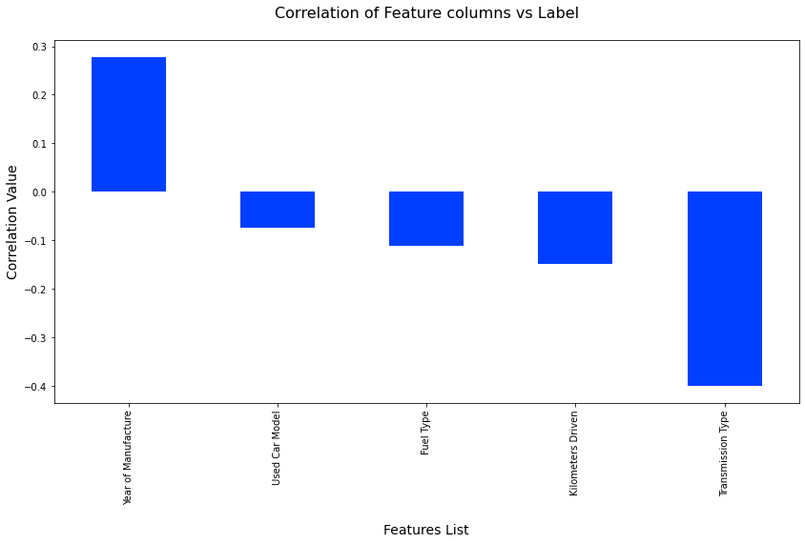
CORRELATIONS BAR GRAPH

Slide 27
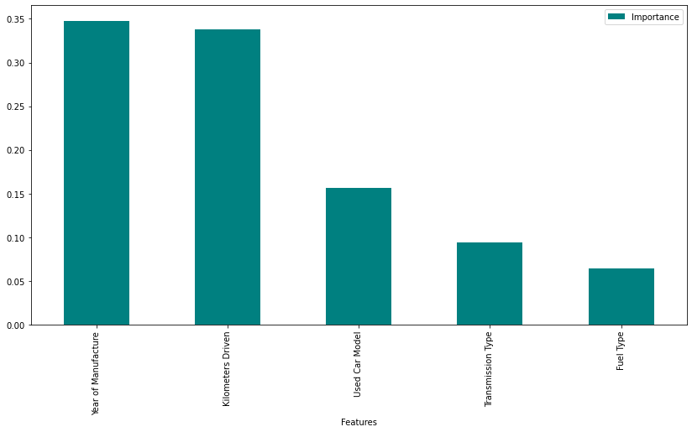
FEATURE IMPORTANCE BAR GRAPH

Slide 28
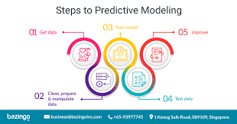
MODEL TRAINING PHASES

Slide 29
REGRESSION MACHINE LEARNING MODEL/S USED
▪ Linear Regression Model
▪ Ridge Regularization Model
▪ Lasso Regularization Model
▪ Support Vector Regression Model
▪ Decision Tree Regression Model
▪ Random Forest Regression Model
▪ K Neighbours Regression Model
▪ Gradient Boosting Regression Model
▪ Ada Boost Regression Model
▪ Extra Trees Regression Model

Slide 30
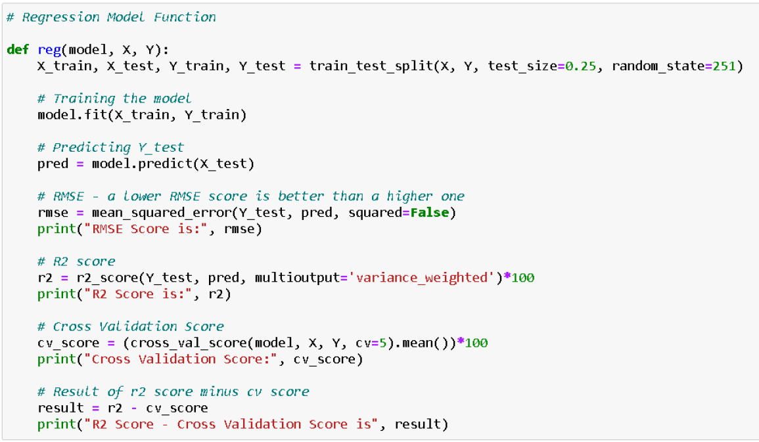
REGRESSION MODEL FUNCTION WITH EVALUATION METRICS

Slide 31
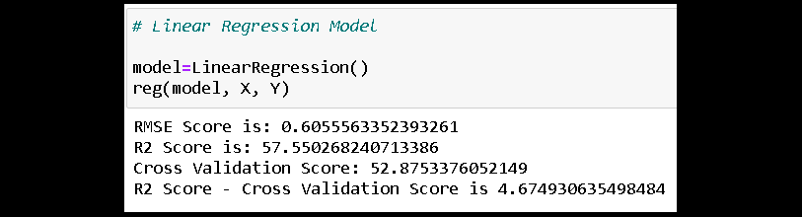
RESULT OF MULTIPLE REGRESSION MODELS

Slide 32
EVALUATION AND HYPER PARAMETER TUNING
The key metrics used here were:
R2 score
Cross Validation Score
MAE
MSE
RMSE
We tried to find out the best parameters list to increase our accuracy scores by using Hyperparameter Tuning. In order to achieve a higher score we used the Grid Search CV method with 5 folds.

Slide 33
CONCLUSION
We gained knowledge into how to gather data, pre-process the data, analyse the data, and construct a model after completing this project. First, we utilized Web Scraping to acquire data on used automobiles from several websites such as OLX, Car Dekho, Cars 24, and OLA.
Beautiful Soup and Selenium were utilised for web scraping, which provides the advantage of automating our data collection process. We gathered about 10,000 pieces of information, including the selling price of used autos and other relevant details. The scraped data was then integrated into a single data frame and saved as a csv file, which we could then open and examine.

Slide 34
CONCLUSION
We cleaned the data and performed data pre-processing tasks such as discovering and managing null values, eliminating words from numbers, converting objects to int types, data visualization, and handling outliers and skewness, among other things. We started testing multiple machine learning regression techniques to discover the best performing model after separating our train and test data.
According to their r2 score and cross validation scores, the Extra Tree Regressor Algorithm performed well. Then, using Grid Search CV, we used the Hyperparameter Tuning approach to find the optimal parameters and improve the score. Although the Extra Tree Regressor Algorithm did not do as well as the defaults, we decided to use it for future forecasts because it was still better than the others. After receiving a data frame containing anticipated and real used vehicle pricing details, we stored the final model in pkl format using the joblib package.

Slide 35
LIMITATIONS OF THIS WORK AND SCOPE FOR FUTURE WORK
The limitations we faced during this project were:
The website was badly constructed since scraping took a long time and getting the next page was difficult. In addition, further skill with various web scraping techniques is required. There were more negative connected data than positive correlated data. Outliers and skewness were found, and we had to lose some useful data while dealing with them. Because no instructions for dealing with these fast-paced websites were supplied, the web scraping process took longer.
Future Work Scope:
The current model is confined to used car data, but by training the model appropriately, it may be enhanced for various types of autos. By training the model with more precise data, the total score may be increased even further.

Slide 36


